Slide 1
An Investigation of the Optical Properties of a Water Droplet
Ethan Hu
Honors Research in Physics

Slide 2
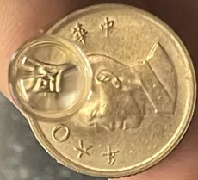
Research Topic
By looking through a single water droplet placed on a glass surface, one can observe that the droplet acts as an imaging system. Investigate the magnification and resolution of such a lens.
What effects the magnification of a water droplet?
What effects the resolution of a water droplet?

Slide 3
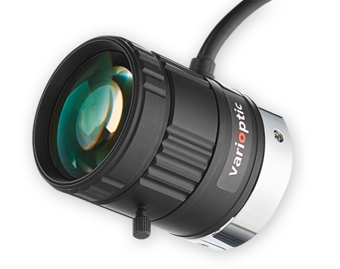
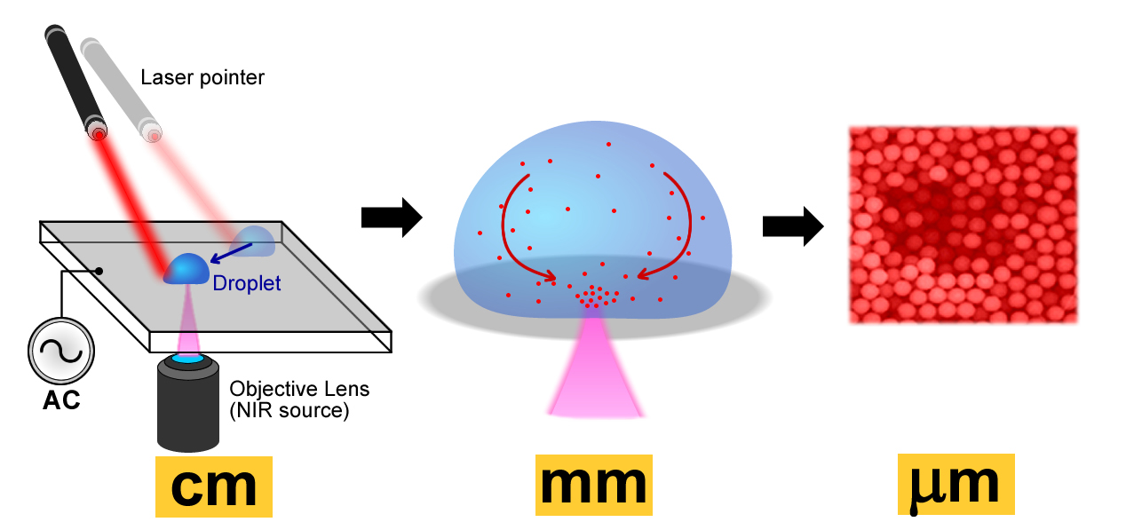
Potential Applications
Liquid Lenses
Lab on a Chip
https://www.phase1vision.com/liquid-lens
https://phys.org/news/2011-07-laser-electric-fields-combined-lab-on-chip.html

Slide 4
Explanation of Phenomenon

Slide 5
Explanation of Phenomenon

Slide 6
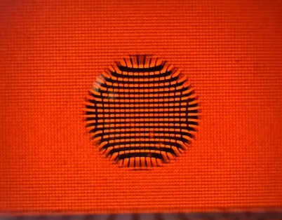
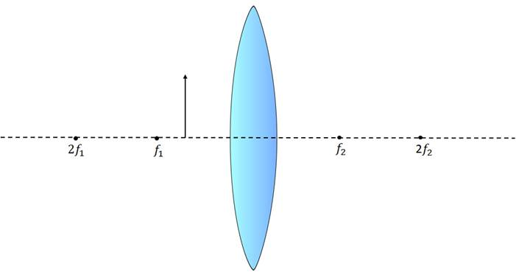

What is Magnification?
M = Image Size / Object Size
Gaussian optics -> $f={\left(\frac{1}{d_{o}}+\frac{1}{d_{i}}\right)}^{−1}, M=\frac{f}{d_{o}+f}$
How do we get focal length? Raytracing
Additionally, the magnification is affected by aberrations
See Pincushion Distortion in the Image

Slide 7
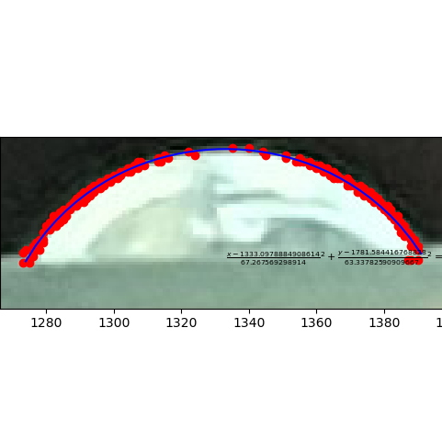
Droplet Shape
We can assume the droplet forms an elliptical shape
Image Processing Steps
Take photo with raw format
Greyscale by averaging the 3 intensity values
Take horizontal derivative
Isolate region in which we look at edges using two quadratic functions
Fit ellipse equation

Slide 8
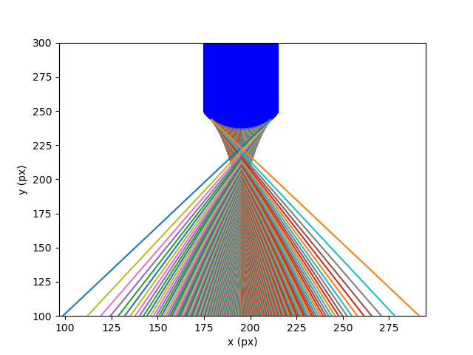
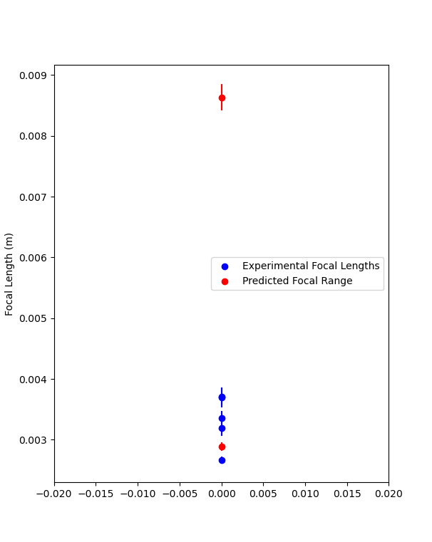
Raytracing

Slide 9
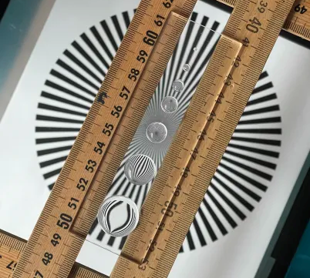
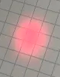
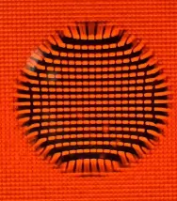
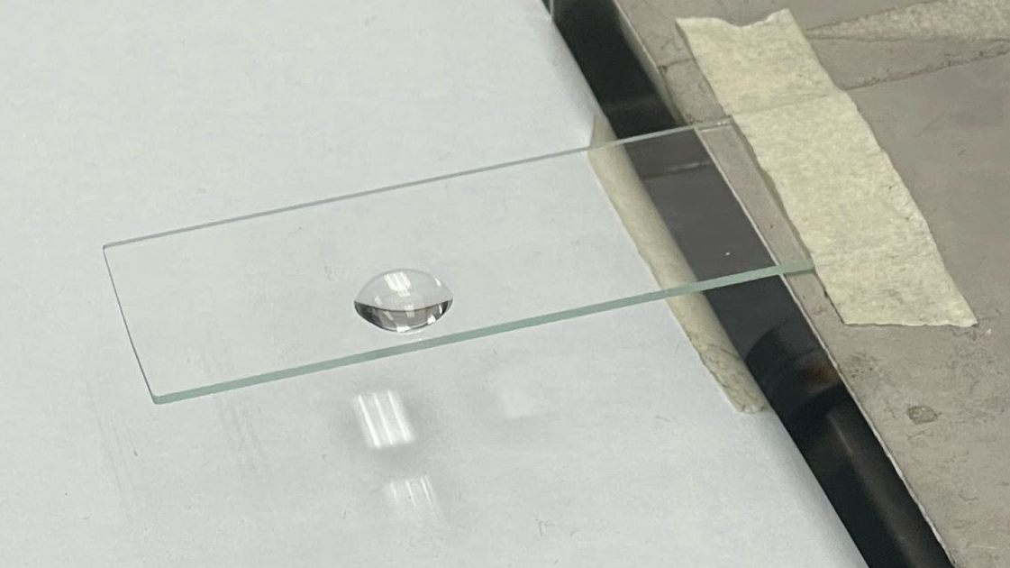
Experiments
Object Image
When collecting magnification data, it didn’t correspond to our formula
Started by using the ceiling light
Tried using a resolution test pattern
Tried using a laser to simulate a Point Source
-> LEDs on Laptop + ImageJ
Used jack to adjust distances between the lens, object, and image

Slide 10
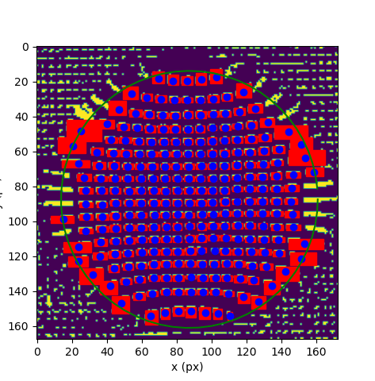
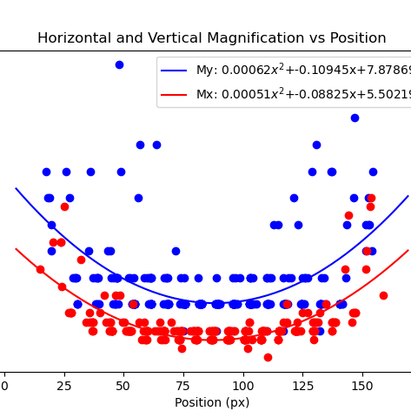
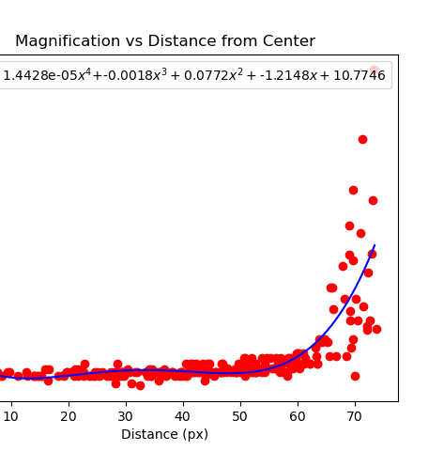
Magnification
Used ImageJ to isolate pixels
Grabbed magnification and position data of pixels under droplet
Shows spherical aberration

Slide 11
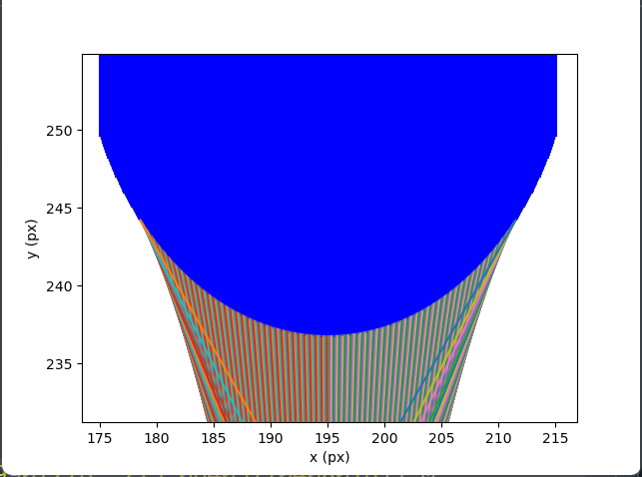
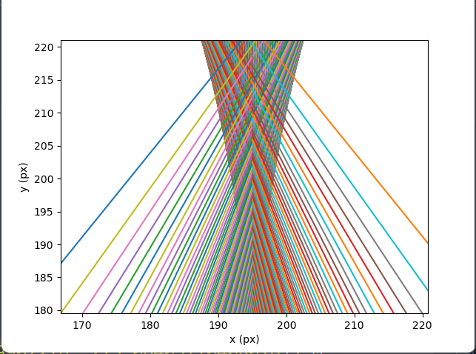
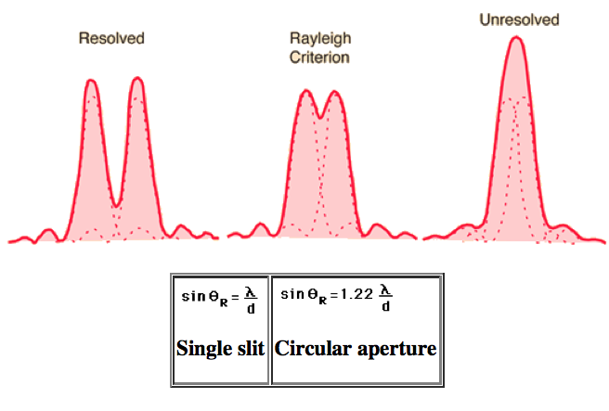
What is Resolution?
Smallest Distance we can see between two points
Diffraction Limited -> Rayleigh Criterion
Aberration Limits -> PSF function
https://roley-physics.weebly.com/rayleigh-criterion.html
Notes:
https://roley-physics.weebly.com/rayleigh-criterion.html

Slide 12
Appendix
Code and Experimental Setup

Slide 13
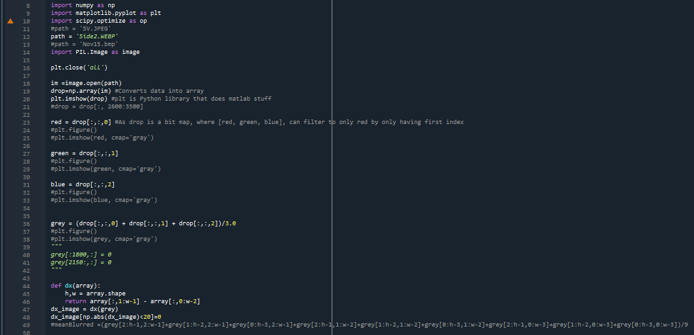
Curvature Code
Point Selection
-Define a region using two parabolas
-Select all points whose derivatives are greater than the filter level
Image Filtering
-Greyscale
-Horizontal Derivative
Fit a elliptical function

Slide 14
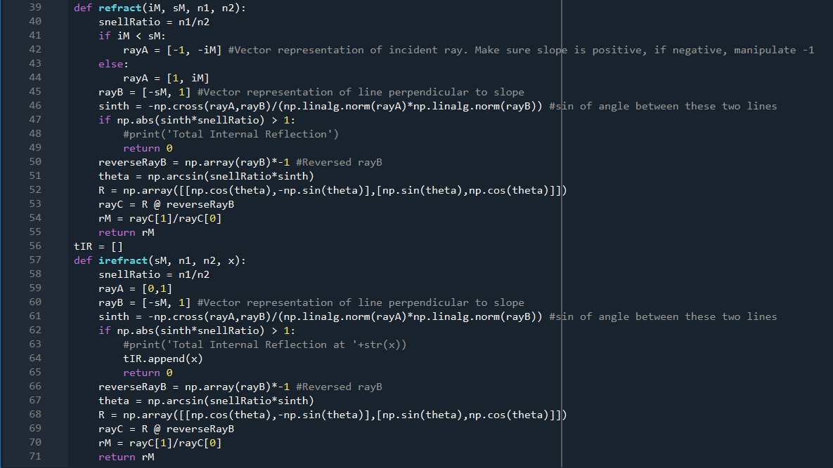
Refraction Function

Slide 15
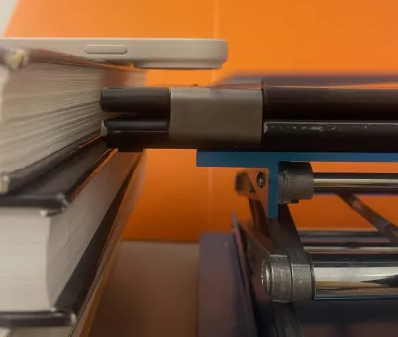
Experimental Setup

